Slide 1

Transform Data with

Slide 2

babynames.csv
Names and sex of babies born in the US from 1880 to 2017. 1.9M rows.
year,sex,name,n,prop
1880,F,Mary,7065,0.07238359
1880,F,Anna,2604,0.02667896
1880,F,Emma,2003,0.02052149
1880,F,Elizabeth,1939,0.01986579
1880,F,Minnie,1746,0.01788843
1880,F,Margaret,1578,0.0161672
1880,F,Ida,1472,0.01508119
1880,F,Alice,1414,0.01448696

Slide 3
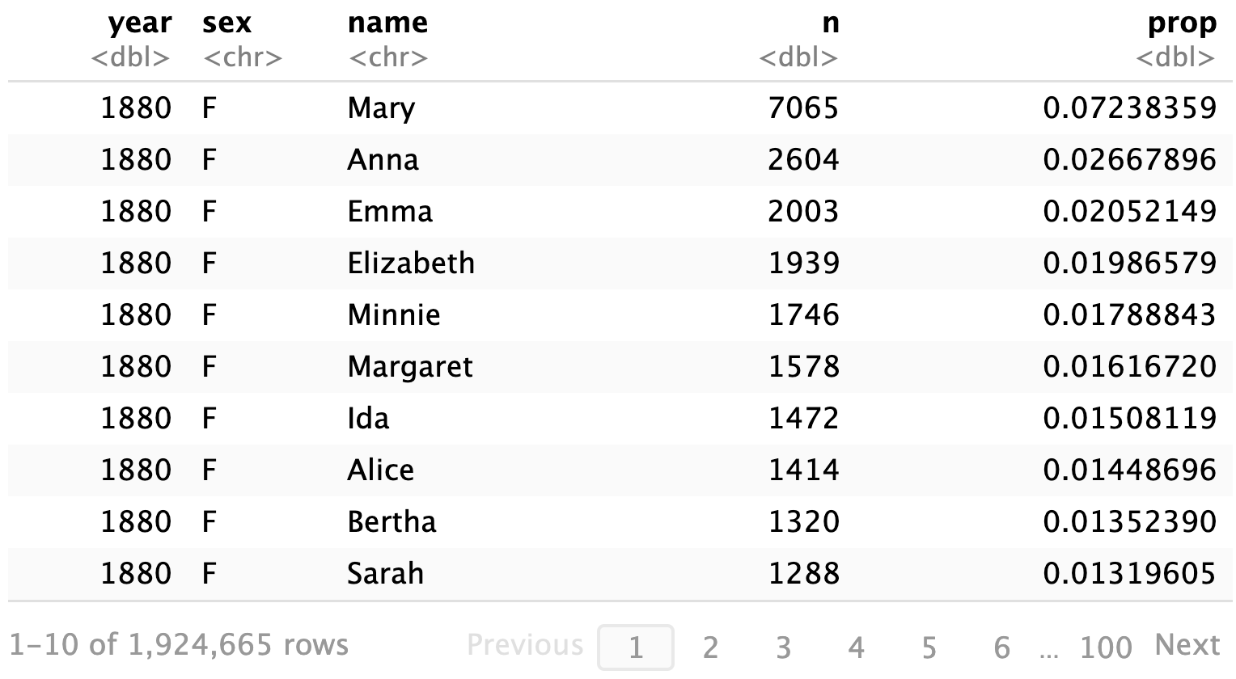
babynames

Slide 4
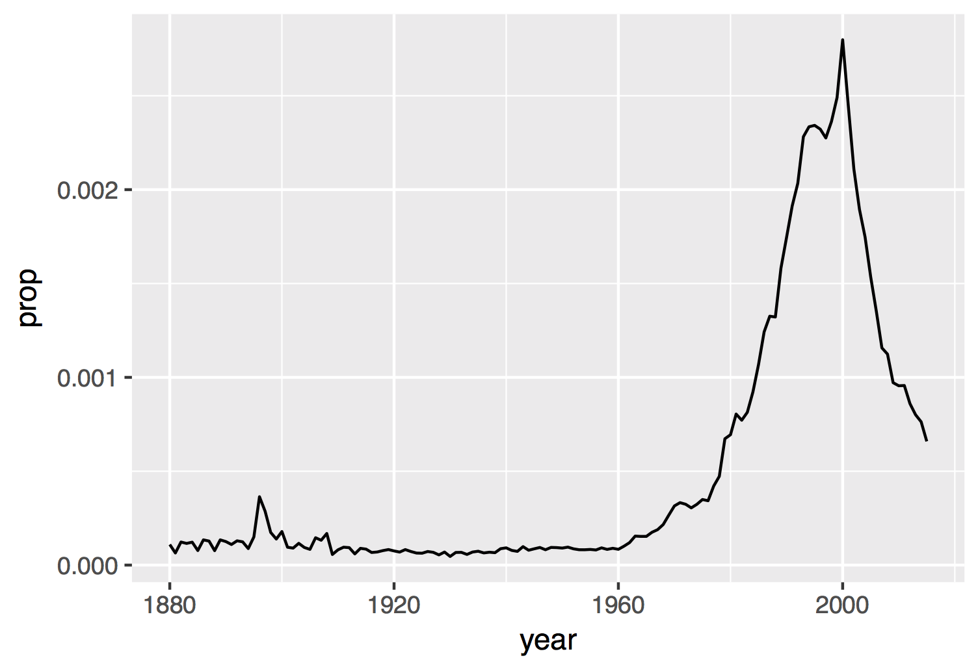
Proportion of boys with the name Garrett

Slide 5
Visualize
Import
Tidy
Model
Reason
Communicate
Transform
Program
Notes:
We'll start with visualizing data. I need everyone to be able to visualize their data with confidence. This will make it easier to understand what we're doing when we start transforming data later in the workshop.

Slide 6

babynames.csv
year,sex,name,n,prop
1880,F,Mary,7065,0.07238359
1880,F,Anna,2604,0.02667896
1880,F,Emma,2003,0.02052149
1880,F,Elizabeth,1939,0.01986579
1880,F,Minnie,1746,0.01788843
1880,F,Margaret,1578,0.0161672
1880,F,Ida,1472,0.01508119
1880,F,Alice,1414,0.01448696

Slide 7
babynames.csv
year,sex,name,n,prop
1880,F,Mary,7065,0.07238359
1880,F,Anna,2604,0.02667896
1880,F,Emma,2003,0.02052149
1880,F,Elizabeth,1939,0.01986579
1880,F,Minnie,1746,0.01788843
1880,F,Margaret,1578,0.0161672
1880,F,Ida,1472,0.01508119
1880,F,Alice,1414,0.01448696

Slide 8

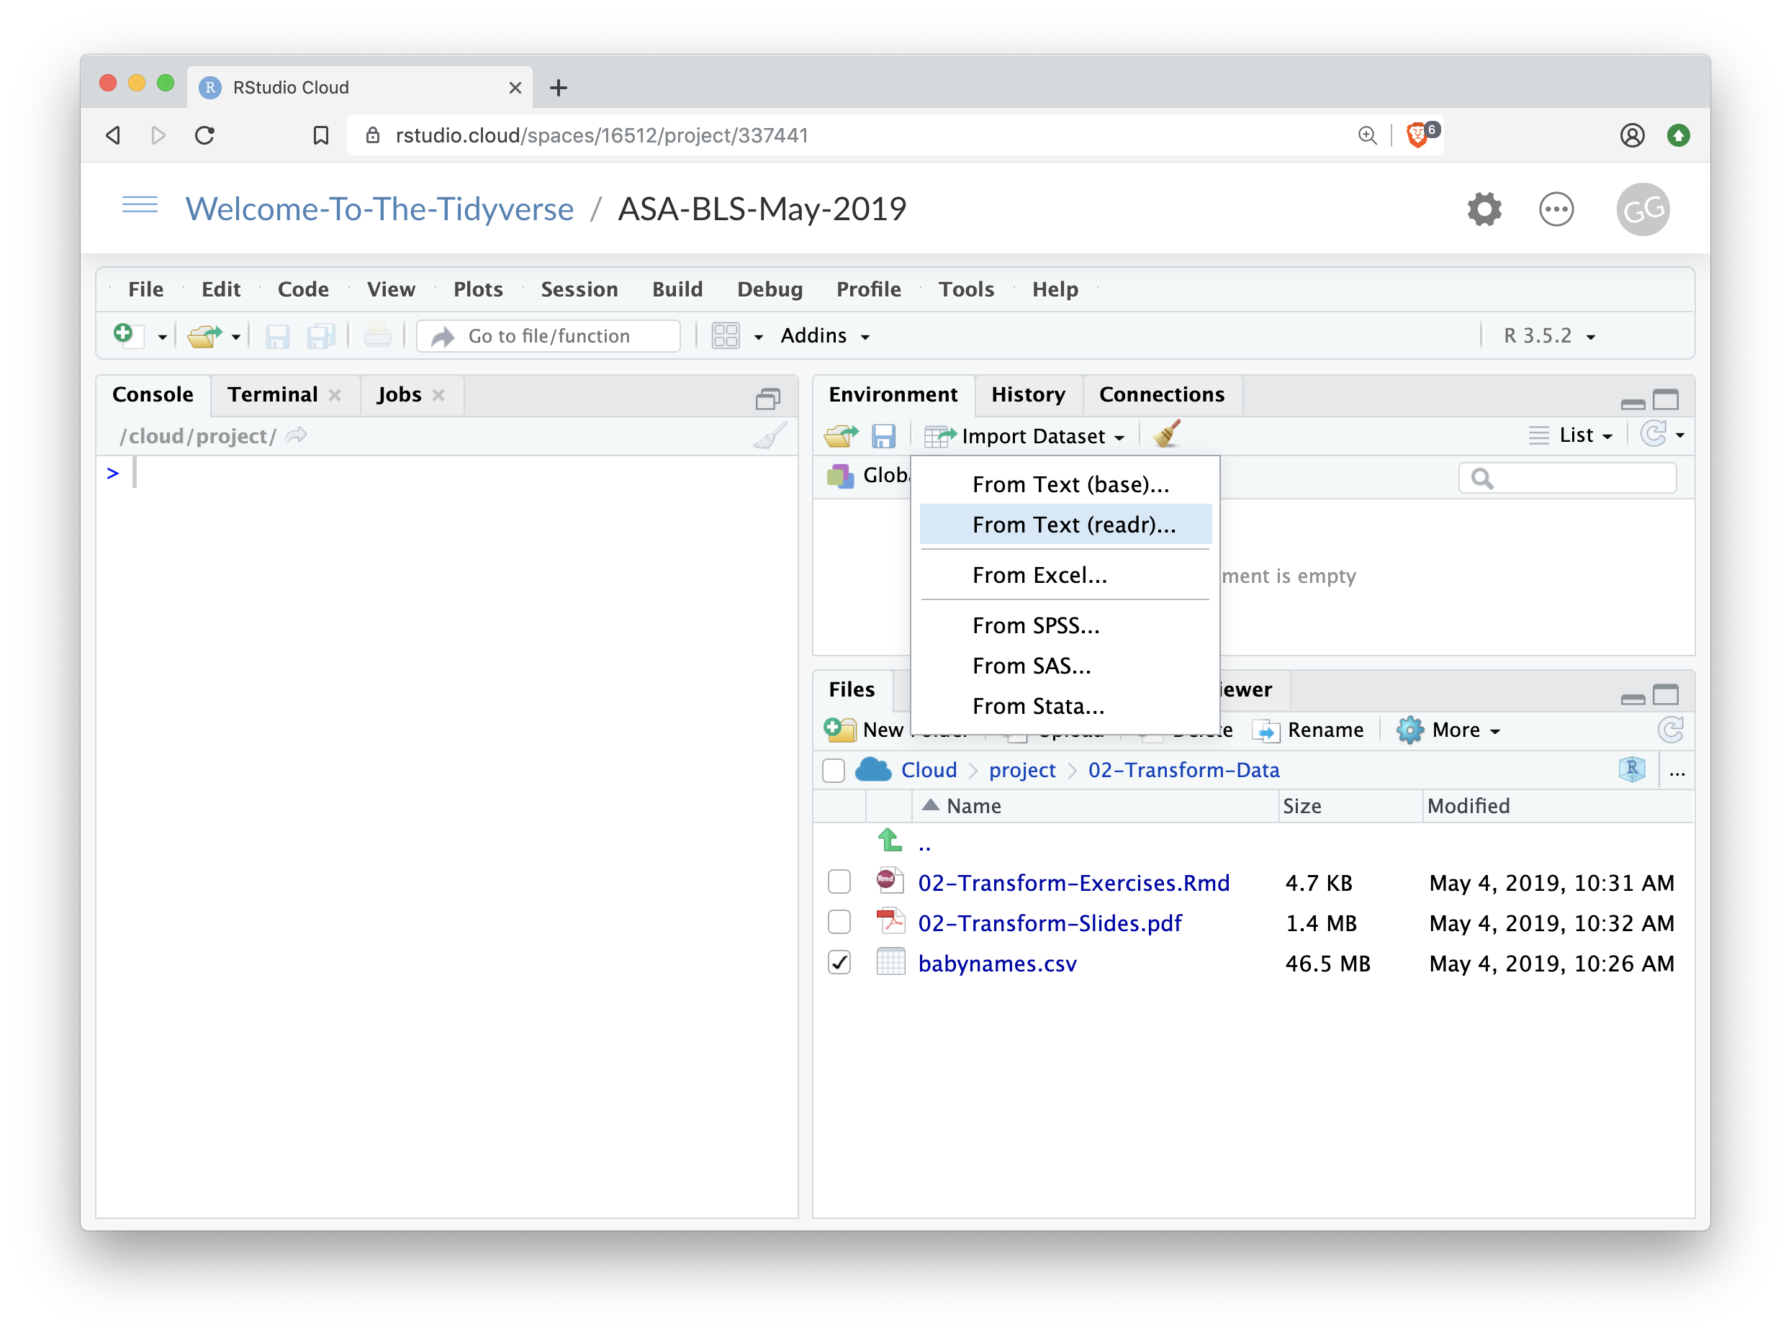

Import
Click Import Dataset From Text (readr)…
8

Slide 9
But is this reproducible?
Why would that matter?
9

Slide 10
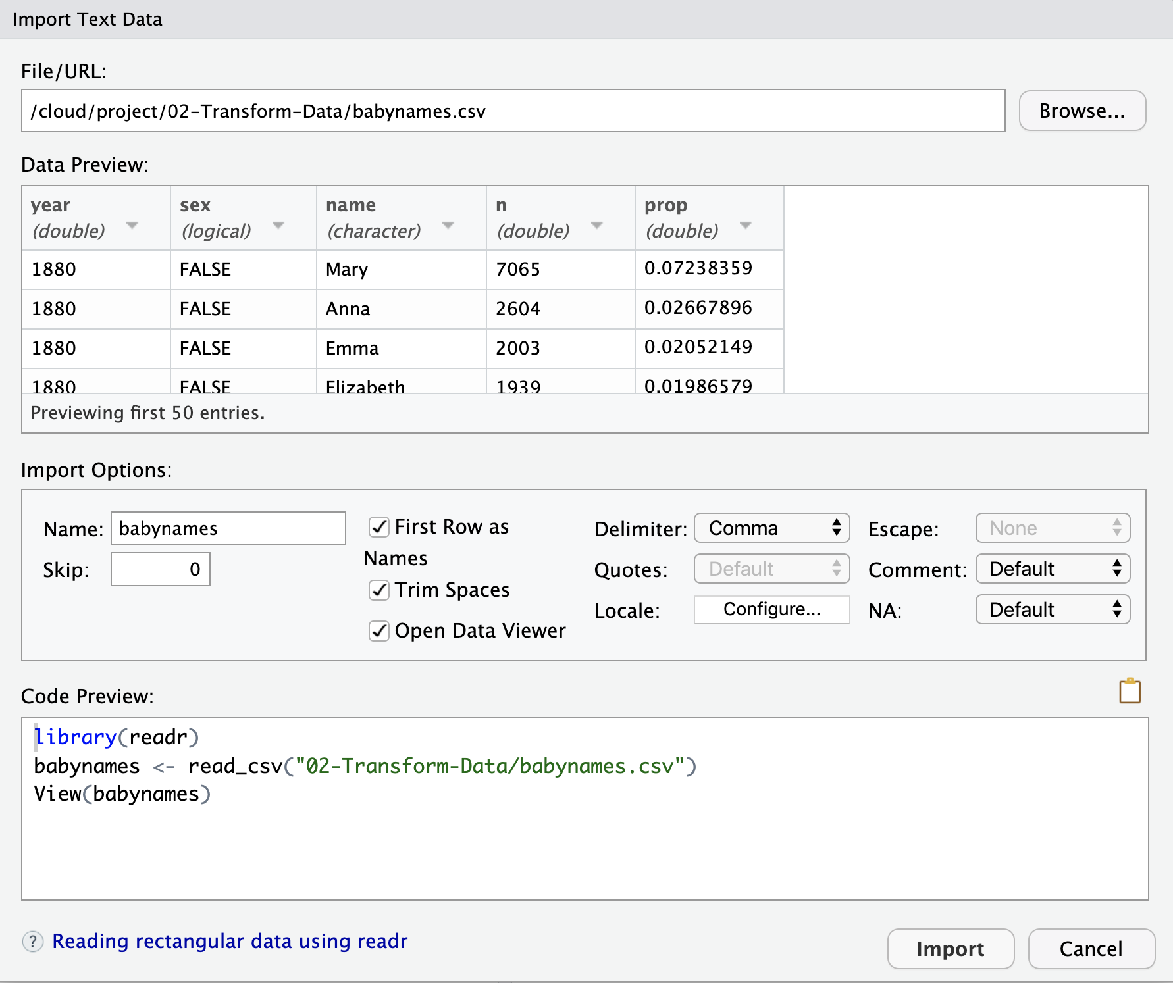

The Code Equivalent

Slide 11
Dealing with file paths
R starts looking for files in a working directory – which you can define: setwd()
But: scripts with setwd() will only work on your current machine.
And: working directory is clear when you run code within Rmarkdown or when you knit … the folder where the Rmd-file is saved.
Recommended:
Either: keep Rmd and data in same folder or data in subfolder
In same folder: use filenames only
In sub-folder: data/filename
Run all file-related commands in chunks, not Console
Select files with auto-complete – type read_csv(“TAB
Or: use RStudio Projects and the here package
here(“data”, “mydata.csv”) gives same path in Console and RMarkdown
11

Slide 12
Visualize
Import
!!
Tidy
Model
Reason
Communicate
Transform
Program
Notes:
We'll start with visualizing data. I need everyone to be able to visualize their data with confidence. This will make it easier to understand what we're doing when we start transforming data later in the workshop.

Slide 13
Your Turn 1
Import the babynames.csv dataset. Give it the name babynames.
If you use the visual menu, copy the import code into the setup code chunk in 03-Transform-Exercises and adjust the file path (so the document can reload it later).
02:00
13

Slide 14

write_csv()
Saves data set as a csv on your computer.
write_csv(babynames, path = "babynames.csv")
Table to save
file
path to save at
14

Slide 15
Visualize
Import
Tidy
Model
Communicate
Transform
Program
15

Slide 16
babynames

Slide 17
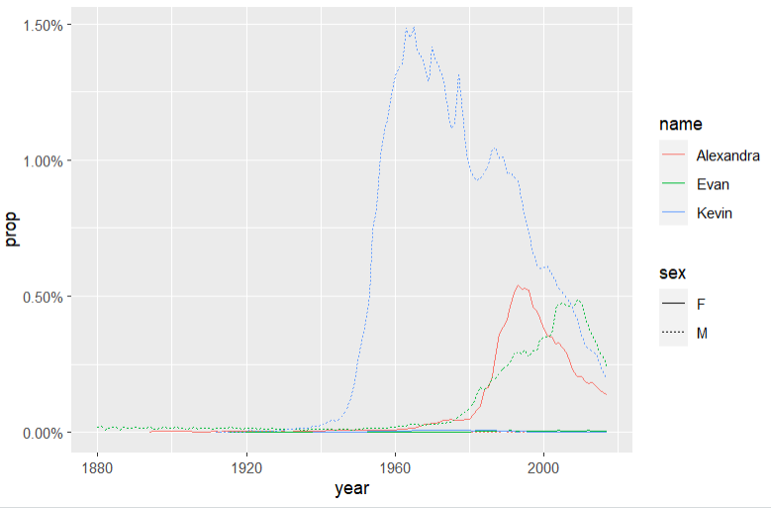
Who has the most popular name?
Which geom?
Notes:
Or least unique?

Slide 18
How to isolate Garrett?
year | sex | name | n | prop
1880 | M | John | 9655 | 0.0815
1880 | M | William | 9532 | 0.0805
1880 | M | James | 5927 | 0.0501
1880 | M | Charles | 5348 | 0.0451
1880 | M | Garrett | 13 | 0.0001
1881 | M | John | 8769 | 0.081
1881 | M | William | 8524 | 0.0787
1881 | M | James | 5442 | 0.0503
1881 | M | Charles | 4664 | 0.0431
1881 | M | Garrett | 7 | 0.0001
1881 | M | Gideon | 7 | 0.0001
year | name | prop
1880 | Garrett | 0.0001
1881 | Garrett | 0.0001
… | Garrett | …
18

Slide 19

dplyr

Slide 20
dplyr
A package that transforms data.
dplyr implements a grammar for transforming tabular data.
20

Slide 21
Isolating data
filter() - extract cases/rows
arrange() - reorder cases/rows
select() - extract variables/columns
21

Slide 22
filter()

Slide 23
filter()
Extract rows that meet logical criteria.
filter(.data, … )
data frame to transform
one or more logical tests (filter returns each row for which the test is TRUE)
23

Slide 24
filter()
Extract rows that meet logical criteria.
filter(babynames, name == "Garrett")
babynames
year | sex | name | n | prop
1880 | M | John | 9655 | 0.0815
1880 | M | William | 9532 | 0.0805
1880 | M | James | 5927 | 0.0501
1880 | M | Charles | 5348 | 0.0451
1880 | M | Garrett | 13 | 0.0001
1881 | M | John | 8769 | 0.081
1881 | M | William | 8524 | 0.0787
1881 | M | James | 5442 | 0.0503
1881 | M | Charles | 4664 | 0.0431
1881 | M | Garrett | 7 | 0.0001
1881 | M | Gideon | 7 | 0.0001
year | sex | name | n | prop
1880 | M | Garrett | 13 | 0.0001
1881 | M | Garrett | 7 | 0.0001
… | … | Garrett | … | …
24

Slide 25
filter()
Extract rows that meet logical criteria.
filter(babynames, name == "Garrett")
= sets
(returns nothing)
== tests if equal
(returns TRUE or FALSE)
babynames
year | sex | name | n | prop
1880 | M | John | 9655 | 0.0815
1880 | M | William | 9532 | 0.0805
1880 | M | James | 5927 | 0.0501
1880 | M | Charles | 5348 | 0.0451
1880 | M | Garrett | 13 | 0.0001
1881 | M | John | 8769 | 0.081
1881 | M | William | 8524 | 0.0787
1881 | M | James | 5442 | 0.0503
1881 | M | Charles | 4664 | 0.0431
1881 | M | Garrett | 7 | 0.0001
1881 | M | Gideon | 7 | 0.0001
25

Slide 26
Logical tests
?Comparison
x < y | Less than
x > y | Greater than
x == y | Equal to
x <= y | Less than or equal to
x >= y | Greater than or equal to
x != y | Not equal to
x %in% y | Group membership
is.na(x) | Is NA
!is.na(x) | Is not NA
26

Slide 27
x <- 1
x >= 2
# FALSE
27

Slide 28
x <- c(1, 2, 3)
x >= 2
# FALSE TRUE TRUE
28

Slide 29
Pop Quiz
What might NA stand for?
1
"1"
"one"
NA
29

Slide 30

Pop Quiz
What might NA stand for?
1
"1"
"one"
NA
Missing Value (Not Available)
30

Slide 31
Note: NA is strong
1 == 1
TRUE
1 == NA
NA
NA == NA
NA
31

Slide 32
Pop Quiz
What is the result?
is.na(NA)
32

Slide 33
Pop Quiz
What is the result?
is.na(NA)
TRUE
33

Slide 34
Logical tests
?Comparison
x < y | Less than
x > y | Greater than
x == y | Equal to
x <= y | Less than or equal to
x >= y | Greater than or equal to
x != y | Not equal to
x %in% y | Group membership
is.na(x) | Is NA
!is.na(x) | Is not NA
34

Slide 35
Your Turn 2
Use filter, babynames, and the logical operators to find:
• All rows where prop is greater than or equal to 0.08
• All children named “Sea”
03:00
35

Slide 36
filter(babynames, prop >= 0.08)
# year sex name n prop
# 1 1880 M John 9655 0.08154630
# 2 1880 M William 9531 0.08049899
# 3 1881 M John 8769 0.08098299
filter(babynames, name == "Sea")
# year sex name n prop
# 1 1982 F Sea 5 2.756771e-06
# 2 1985 M Sea 6 3.119547e-06
# 3 1986 M Sea 5 2.603512e-06
# 4 1998 F Sea 5 2.580377e-06
36

Slide 37
Two common mistakes
1. Using = instead of ==
filter(babynames, name = "Sea")
filter(babynames, name == "Sea")
2. Forgetting quotes around strings (words)
filter(babynames, name == Sea)
filter(babynames, name == "Sea")
37

Slide 38
filter()
Extract rows that meet every logical criteria.
filter(babynames, name == "Garrett", year == 1880)
babynames
year | sex | name | n | prop
1880 | M | John | 9655 | 0.0815
1880 | M | William | 9532 | 0.0805
1880 | M | James | 5927 | 0.0501
1880 | M | Charles | 5348 | 0.0451
1880 | M | Garrett | 13 | 0.0001
1881 | M | John | 8769 | 0.081
1881 | M | William | 8524 | 0.0787
1881 | M | James | 5442 | 0.0503
1881 | M | Charles | 4664 | 0.0431
1881 | M | Garrett | 7 | 0.0001
1881 | M | Gideon | 7 | 0.0001
year | sex | name | n | prop
1880 | M | Garrett | 13 | 0.0001
38

Slide 39
filter()
Extract rows that meet every logical criteria.
filter(babynames, name == "Garrett" & year == 1880)
babynames
year | sex | name | n | prop
1880 | M | John | 9655 | 0.0815
1880 | M | William | 9532 | 0.0805
1880 | M | James | 5927 | 0.0501
1880 | M | Charles | 5348 | 0.0451
1880 | M | Garrett | 13 | 0.0001
1881 | M | John | 8769 | 0.081
1881 | M | William | 8524 | 0.0787
1881 | M | James | 5442 | 0.0503
1881 | M | Charles | 4664 | 0.0431
1881 | M | Garrett | 7 | 0.0001
1881 | M | Gideon | 7 | 0.0001
year | sex | name | n | prop
1880 | M | Garrett | 13 | 0.0001
39

Slide 40
Boolean operators
?base::Logic
a & b | and
a | b | or
xor(a,b) | exactly or
!a | not
( ) | To group tests. & evaluates before |
40

Slide 41
Your Turn 3
Use Boolean operators to alter the code below to return only the rows that contain:
• Boys named Sue
• Names that were used by exactly 5 or 6 children in 1880
• Names that are one of Acura, Lexus, or Yugo
04:00
41

Slide 42
filter(babynames, name == "Sue", sex == "M")
# year sex name n prop
# 1 1917 M Sue 7 0.0000073
# 2 1927 M Sue 5 0.0000043
# … … … … … …
filter(babynames, (n == 5 | n == 6) & year == 1880)
# year sex name n prop
# 1 1880 F Abby 6 6.147289e-05
# 2 1880 F Aileen 6 6.147289e-05
# … … … … … …
Parentheses matter
filter(babynames, name == "Acura" | name =="Lexus" | name =="Yugo")
# year sex name n prop
# 1 1990 F Lexus 36 1.752932e-05
# 2 1990 M Lexus 12 5.579156e-06
# … … … … … …

Slide 43
Two more common mistakes
3. Collapsing multiple tests into one
filter(babynames, 10 < n < 20)
filter(babynames, 10 < n, n < 20)
4. Stringing together many tests (when you could use %in%)
filter(babynames, n == 5 | n == 10 | n == 15 | n == 20)
filter(babynames, n %in% c(5, 10, 15, 20))
43

Slide 44
filter(babynames, name == "Sue", sex == "M")
# year sex name n prop
# 1 1917 M Sue 7 0.0000073
# 2 1927 M Sue 5 0.0000043
# … … … … … …
filter(babynames, (n == 5 | n == 6) & year == 1880)
# year sex name n prop
# 1 1880 F Abby 6 6.147289e-05
# 2 1880 F Aileen 6 6.147289e-05
# … … … … … …
filter(babynames, name == "Acura" | name =="Lexus" |name =="Yugo")
# year sex name n prop
# 1 1990 F Lexus 36 1.752932e-05
# 2 1990 M Lexus 12 5.579156e-06
# … … … … … …
Or use %in% c(“Acura”, “Lexus”, “Yugo”)

Slide 45
arrange()

Slide 46
arrange()
Order rows from smallest to largest values.
arrange(.data, …)
data frame to transform
one or more columns to order by
(additional columns will be used as tie breakers)
46

Slide 47
common dplyr syntax
arrange(.data, … )
dplyr function
function specific arguments
data frame to transform (always first)
Always returns a data frame / tibble.
47

Slide 48
arrange()
Order rows from smallest to largest values.
arrange(babynames, n)
babynames
year | sex | name | n | prop
1880 | M | John | 9655 | 0.0815
1880 | M | William | 9532 | 0.0805
1880 | M | James | 5927 | 0.0501
1880 | M | Charles | 5348 | 0.0451
1880 | M | Garrett | 13 | 0.0001
1881 | M | John | 8769 | 0.081
1881 | M | William | 8524 | 0.0787
1881 | M | James | 5442 | 0.0503
1881 | M | Charles | 4664 | 0.0431
1881 | M | Garrett | 7 | 0.0001
1881 | M | Gideon | 7 | 0.0001
year | sex | name | n | prop
1880 | M | Garrett | 13 | 0.0001
1880 | M | Charles | 5348 | 0.0451
1880 | M | James | 5927 | 0.0501
1881 | M | John | 8769 | 0.081
1880 | M | William | 9532 | 0.0805
1880 | M | John | 9655 | 0.0815
1881 | M | William | 8524 | 0.0787
1881 | M | James | 5442 | 0.0503
1881 | M | Charles | 4664 | 0.0431
1881 | M | Garrett | 7 | 0.0001
1881 | M | Gideon | 7 | 0.0001
48

Slide 49
desc()
Changes ordering to largest to smallest.
arrange(babynames, desc(n)) OR arrange(babynames, -n)
babynames
year | sex | name | n | prop
1880 | M | John | 9655 | 0.0815
1880 | M | William | 9532 | 0.0805
1880 | M | James | 5927 | 0.0501
1880 | M | Charles | 5348 | 0.0451
1880 | M | Garrett | 13 | 0.0001
1881 | M | John | 8769 | 0.081
1881 | M | William | 8524 | 0.0787
1881 | M | James | 5442 | 0.0503
1881 | M | Charles | 4664 | 0.0431
1881 | M | Garrett | 7 | 0.0001
1881 | M | Gideon | 7 | 0.0001
year | sex | name | n | prop
1880 | M | John | 9655 | 0.0815
1880 | M | William | 9532 | 0.0805
1881 | M | John | 8769 | 0.081
1880 | M | James | 5927 | 0.0501
1880 | M | Charles | 5348 | 0.0451
1880 | M | Garrett | 13 | 0.0001
1881 | M | William | 8524 | 0.0787
1881 | M | James | 5442 | 0.0503
1881 | M | Charles | 4664 | 0.0431
1881 | M | Garrett | 7 | 0.0001
1881 | M | Gideon | 7 | 0.0001
49

Slide 50
Your Turn 4
What was the most popular name in a single year? Use arrange() to find:
the highest n
the highest prop
Remember that you can invert by using desc() or –
02:00
50

Slide 51
arrange(babynames, desc(prop))
# year sex name n prop
# 1 1880 M John 9655 0.08154630
# 2 1881 M John 8769 0.08098299
# 3 1880 M William 9531 0.08049899
# 4 1883 M John 8894 0.07907324
# 5 1881 M William 8524 0.07872038
# 6 1882 M John 9557 0.07831617
# 7 1884 M John 9388 0.07648751
# 8 1882 M William 9298 0.07619375
# 9 1886 M John 9026 0.07582198
# 10 1885 M John 8756 0.07551791
# ... with 1,858,679 more rows
arrange(babynames, desc(n))
# year sex name n prop
# 1 1947 F Linda 99680 0.05483609
# 2 1948 F Linda 96211 0.05521159
# 3 1947 M James 94763 0.05102057
# 4 1957 M Michael 92726 0.04238659
# 5 1947 M Robert 91646 0.04934237
# 6 1949 F Linda 91010 0.05184281
# 7 1956 M Michael 90623 0.04225479
# 8 1958 M Michael 90517 0.04203881
# 9 1948 M James 88588 0.04969679
# 10 1954 M Michael 88493 0.04279403
# ... with 1,858,679 more rows
51

Slide 52
select()

Slide 53
select()
Extract columns by name (or condition).
select(.data, …)
data frame to transform
name(s) of columns to extract
(or a select helper function)
53

Slide 54
select()
Extract columns by name.
select(babynames, name, prop)
babynames
year | sex | name | n | prop
1880 | M | John | 9655 | 0.0815
1880 | M | William | 9532 | 0.0805
1880 | M | James | 5927 | 0.0501
1880 | M | Charles | 5348 | 0.0451
1880 | M | Garrett | 13 | 0.0001
1881 | M | John | 8769 | 0.081
1881 | M | William | 8524 | 0.0787
1881 | M | James | 5442 | 0.0503
1881 | M | Charles | 4664 | 0.0431
1881 | M | Garrett | 7 | 0.0001
1881 | M | Gideon | 7 | 0.0001
name | prop
John | 0.0815
William | 0.0805
James | 0.0501
Charles | 0.0451
Garrett | 0.0001
John | 0.081
William | 0.0787
James | 0.0503
Charles | 0.0431
Garrett | 0.0001
Gideon | 0.0001

Slide 55
Your Turn 5
Alter the code to select just the n column:
select(babynames, name, prop)
01:00
55

Slide 56
select(babynames, n)
# n
# <int>
# 1 7065
# 2 2604
# 3 2003
# 4 1939
# 5 1746
# … …
56

Slide 57
select() helpers
: - Select range of columns
select(ess_mini, height:happy)
- - Select every column but
select(ess_mini, -c(main_activity, working_hours))
starts_with() - Select columns that start with…
select(ess_mini, starts_with("work"))
ends_with() - Select columns that end with…
select(ess_mini, ends_with("t"))
57

Slide 58
select() helpers
matches() - Select columns whose names match a string or regular expression (regex)
select(ess_mini, matches("ei")) select(ess_mini, matches("^.{5}$"))
any_of() / all_of – Select columns whose names are in a set
select(ess_mini, any_of(c("sex", "gender", "Sex", "Gender"))
num_range() - Select columns named in prefix, number style
select(billboard, artist, track, num_range("wk", 10:15))
58

Slide 59
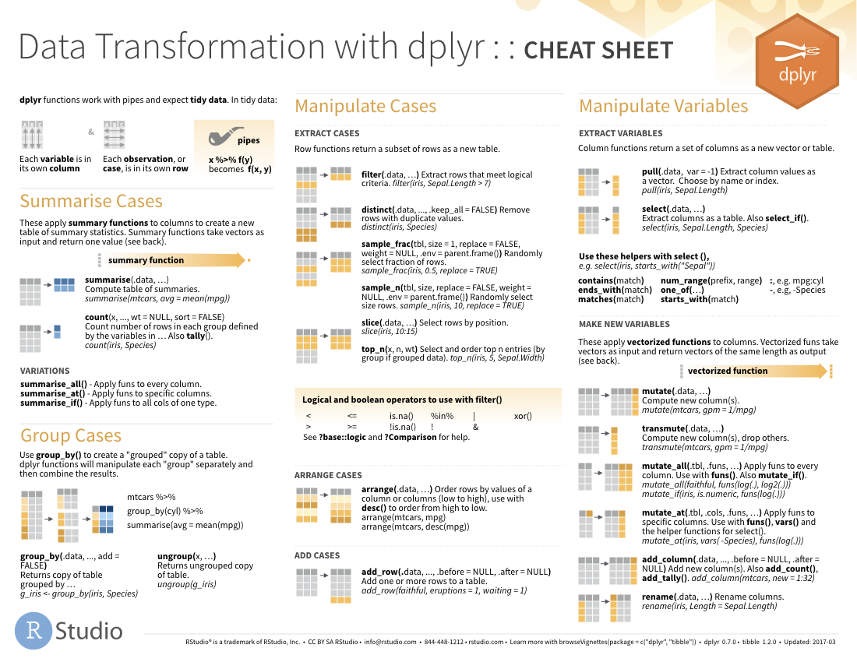
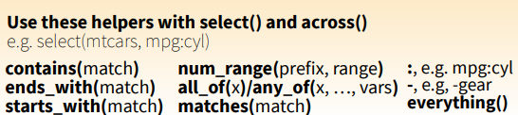
select() helpers
59

Slide 60
Quiz
Which of these is NOT a way to select the name and n columns together?
select(babynames, -c(year, sex, prop))
select(babynames, name:n)
select(babynames, starts_with("n"))
select(babynames, ends_with("n"))
60

Slide 61
Quiz
Which of these is NOT a way to select the name and n columns together?
select(babynames, -c(year, sex, prop))
select(babynames, name:n)
select(babynames, starts_with("n"))
select(babynames, ends_with("n"))
61

Slide 62
%>%

Slide 63
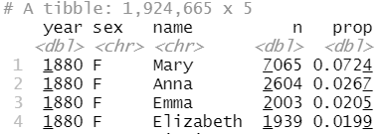
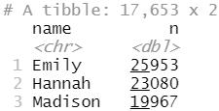
What was the most popular girls name in 2000?
What steps? What functions?

Slide 64
Steps
girls_2000 <- filter(babynames, year == 2000, sex == "F")
girls_2000 <- select(girls_2000, name, n)
girls_2000 <- arrange(girls_2000, desc(n))
girls_2000
64

Slide 65

Steps
girls_2000 <- filter(babynames, year == 2000, sex == "F")
girls_2000 <- select(girls_2000, name, n)
girls_2000 <- arrange(girls_2000, desc(n))
girls_2000
Don’t repeat yourself – we can do better!
65

Slide 66
Traditional approach
arrange(select(filter(babynames, year == 2000, sex == "F"), name, n), desc(n))
Is this better?
66

Slide 67
The pipe operator %>%
%>%
babynames %>% filter( , n == 99680)
Passes result on left into first argument of function on right.
So, these do the same thing. Try it (in a moment).
filter(babynames, n == 99680)
babynames %>% filter(n == 99680)
67

Slide 68
Pipes
babynames
boys_2015 <- filter(babynames, year == 2015, sex == "M")
boys_2015 <- select(boys_2015, name, n)
boys_2015 <- arrange(boys_2015, desc(n))
boys_2015
babynames %>%
filter(year == 2015, sex == "M") %>%
select(name, n) %>%
arrange(desc(n))

Slide 69
student <- "Aubrey"
student %>%
learn(R) %>%
analyse(data) %>%
receive(distinction)
vs.
student <- learn(student, R)
student <- analyse(student, data)
receive(student, distinction)
69

Slide 70
Shortcut to type %>%
Cmd
+
Shift
+
M
(Mac)
Ctrl
+
Shift
+
M
(Windows)
70

Slide 71
Your Turn 6
Use %>% to write a sequence of functions that:
Filters babynames to the girls that were born in 2017, then…
Selects the name and n columns, then…
Arranges the results so that the most popular names are at the top.
04:00
71

Slide 72
babynames %>%
filter(year == 2017, sex == "F") %>%
select(name, n) %>%
arrange(desc(n))
# name n
# 1 Emma 19738
# 2 Olivia 18632
# 3 Ava 15902
# 4 Isabella 15100
# 5 Sophia 14831
# 6 Mia 13437
# 7 Charlotte 12893
# 8 Amelia 11800
# 9 Evelyn 10675
## … with 20,170 more rows

Slide 73
Payoff!

Slide 74
Your Turn 7 - Exam
Trim babynames to just the rows that contain your name and your sex … or your favourite US name
Trim the result to just the columns that will appear in your graph (not necessary for graph, but useful when you display tables)
Plot the results as a line graph with year on the x axis and prop on the y axis
05:00
74

Slide 75
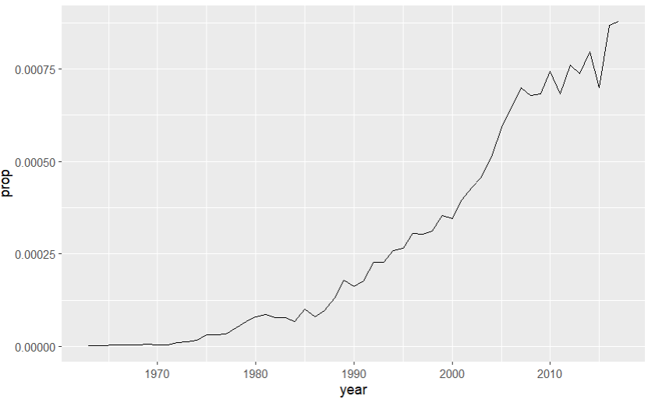
babynames %>%
filter(name == "Lukas", sex == "M") %>%
select(year, prop) %>%
ggplot(aes(x = year, y = prop)) +
geom_line()

Slide 76
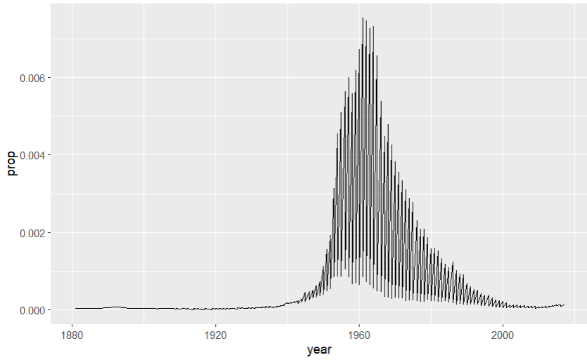
What’s going on?
babynames %>%
filter(name == "Robin") %>%
ggplot(aes(year, prop)) +
geom_line()

Slide 77
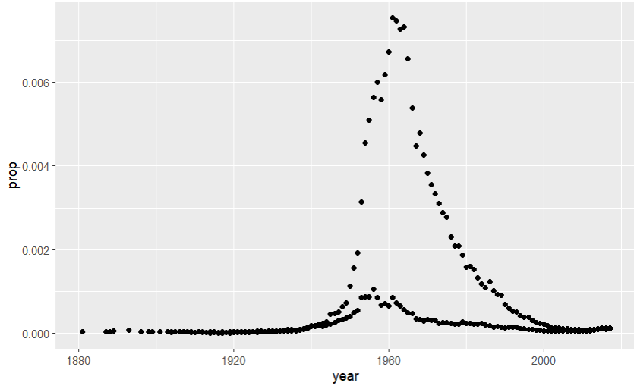
What’s going on?
babynames %>%
filter(name == "Robin") %>%
ggplot(aes(x = year, y = prop)) +
geom_point()
Did not filter on SEX

Slide 78
Plotting groups

Slide 79
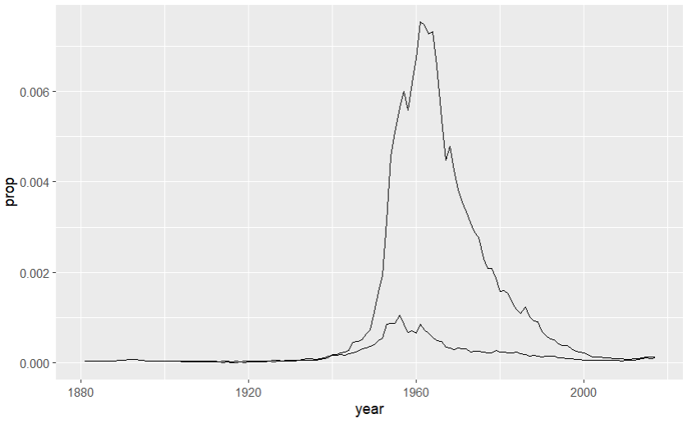
babynames %>%
filter(name == "Robin") %>%
ggplot(aes(x = year, y = prop, group = sex)) +
geom_line()

Slide 80
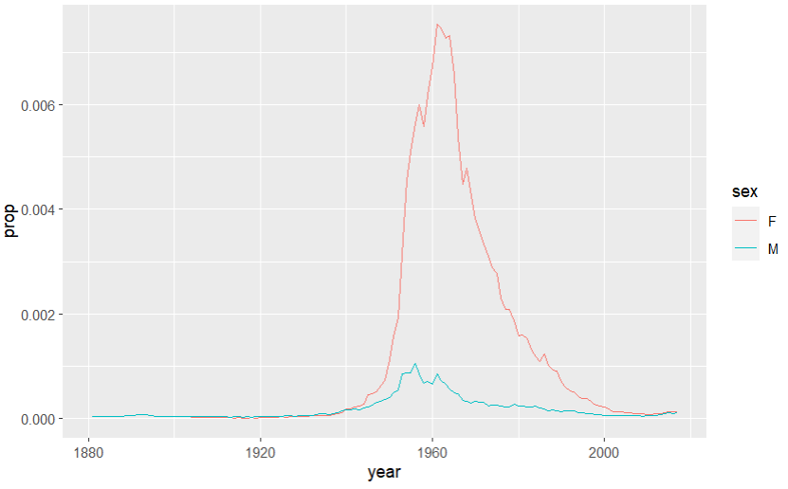
babynames %>%
filter(name == "Robin") %>%
ggplot(aes(year, prop, color = sex)) +
geom_line()

Slide 81
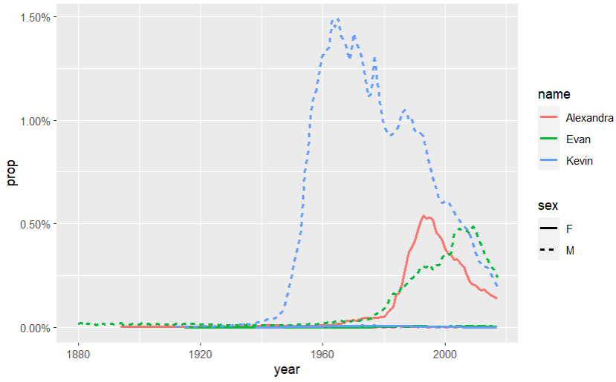
babynames %>% filter(name %in% c("Alexandra", "Evan", "Kevin")) %>% ggplot(aes(x = year, y = prop, color = name, linetype = sex)) + geom_line() + scale_y_continuous(labels = scales::label_percent())

Slide 82
What are the most popular names?

Slide 83
Quiz
Do we have enough information to:
Calculate the total number of children with each name?
83

Slide 84
Deriving information
summarise() - summarise variables
group_by() - group cases
mutate() - create new variables
84

Slide 85
summarise()

Slide 86
summarise()
Compute table of summaries.
babynames %>% summarise(total = sum(n), max = max(n))
babynames
year | sex | name | n | prop
1880 | M | John | 9655 | 0.0815
1880 | M | William | 9532 | 0.0805
1880 | M | James | 5927 | 0.0501
1880 | M | Charles | 5348 | 0.0451
1880 | M | Garrett | 13 | 0.0001
1881 | M | John | 8769 | 0.081
1881 | M | William | 8524 | 0.0787
1881 | M | James | 5442 | 0.0503
1881 | M | Charles | 4664 | 0.0431
1881 | M | Garrett | 7 | 0.0001
1881 | M | Gideon | 7 | 0.0001
total | max
348120517 | 99686
86

Slide 87
Your Turn 8
Complete the code to extract the rows where name == "Khaleesi". Then use summarise() and sum() and min() to find:
The total number of children named Khaleesi
The first year Khaleesi appeared in the data
03:00
87

Slide 88
babynames %>%
filter(name == "Khaleesi") %>%
summarise(total = sum(n), first = min(year))
# total first
# 1 1964 2011
88

Slide 89
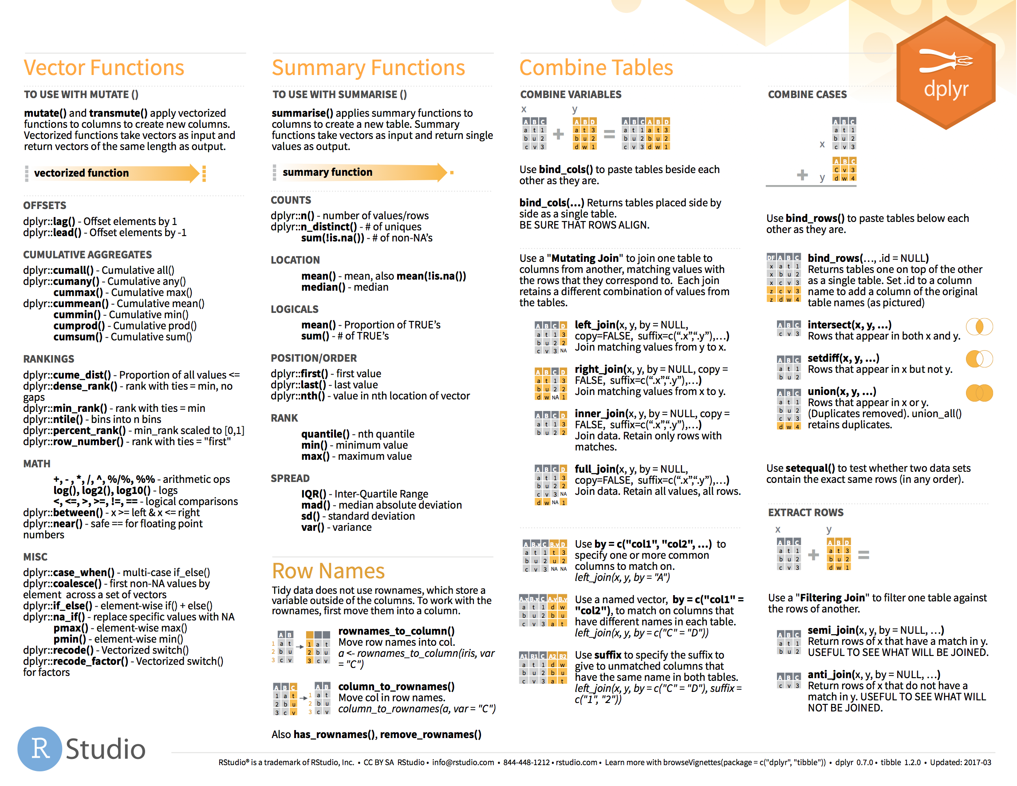
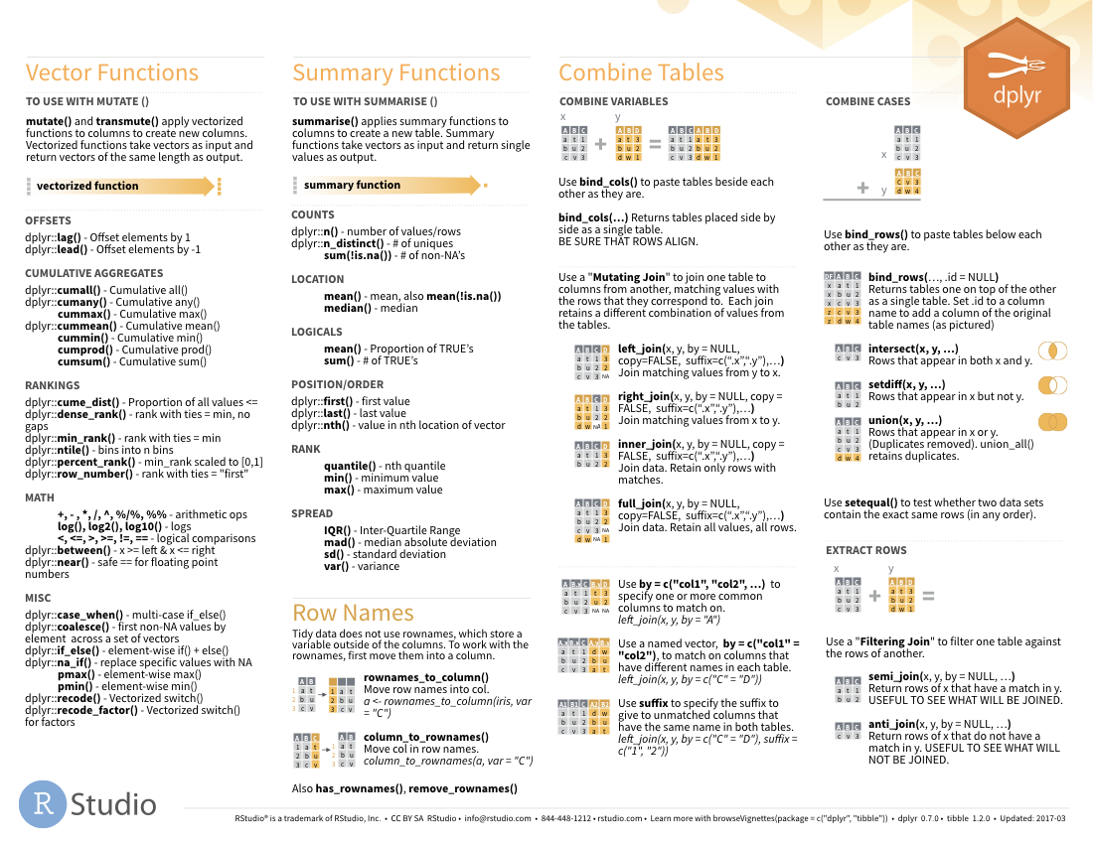

Summary functions
Take a vector as input.
Return a single value as output.
on 2nd page
89

Slide 90
n()
The number of rows in a dataset/group
babynames %>% summarise(n = n())
babynames
year | sex | name | n | prop
1880 | M | John | 9655 | 0.0815
1880 | M | William | 9532 | 0.0805
1880 | M | James | 5927 | 0.0501
1880 | M | Charles | 5348 | 0.0451
1880 | M | Garrett | 13 | 0.0001
1881 | M | John | 8769 | 0.081
1881 | M | William | 8524 | 0.0787
1881 | M | James | 5442 | 0.0503
1881 | M | Charles | 4664 | 0.0431
1881 | M | Garrett | 7 | 0.0001
1881 | M | Gideon | 7 | 0.0001
n
1924665
90

Slide 91
n_distinct()
The number of distinct values in a variable
babynames %>% summarise(n = n(), nname = n_distinct(name))
babynames
year | sex | name | n | prop
1880 | M | John | 9655 | 0.0815
1880 | M | William | 9532 | 0.0805
1880 | M | James | 5927 | 0.0501
1880 | M | Charles | 5348 | 0.0451
1880 | M | Garrett | 13 | 0.0001
1881 | M | John | 8769 | 0.081
1881 | M | William | 8524 | 0.0787
1881 | M | James | 5442 | 0.0503
1881 | M | Charles | 4664 | 0.0431
1881 | M | Garrett | 7 | 0.0001
1881 | M | Gideon | 7 | 0.0001
n | nname
1924665 | 97310
91

Slide 92
How should we define popularity?
A name is popular if:
Sums - a large number of children have the name when you sum across years
Ranks - it consistently ranks among the top names from year to year.
92

Slide 93
babynames %>%
filter(name == "Khaleesi" & sex == "F")
## year sex name n prop
## 1 2011 F Khaleesi 28 0.0000145
## 2 2012 F Khaleesi 146 0.0000754
## 3 2013 F Khaleesi 243 0.000126
## 4 2014 F Khaleesi 369 0.000189
## 5 2015 F Khaleesi 341 0.000175
## 6 2016 F Khaleesi 371 0.000192
## 7 2017 F Khaleesi 466 0.000249

Slide 94
babynames %>%
filter(name == "Khaleesi" & sex == "F") %>%
summarise(total = sum(n))
## total
## 1 1964
Can we do this for
each name?

Slide 95
Grouping
cases

Slide 96
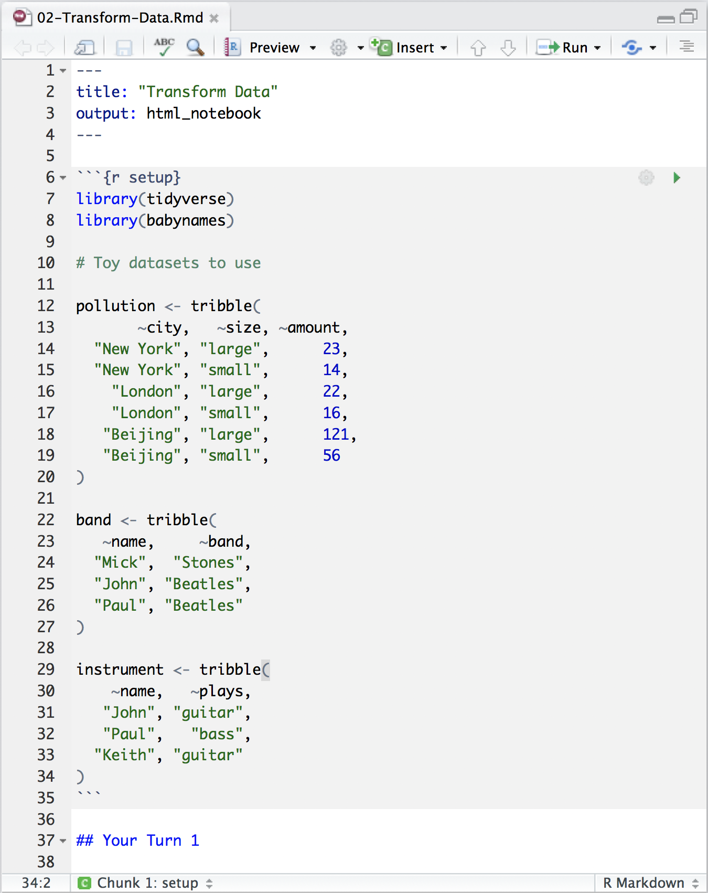
03-Transform-Exercises.Rmd
Toy data set to practice with
Notes:
Tribbles are a way to enter (very) small datasets

Slide 97
pollution
city | particle size | amount (µg/m³)
New York | large | 23
New York | small | 14
London | large | 22
London | small | 16
Beijing | large | 121
Beijing | small | 56
97

Slide 98
city | particle size | amount (µg/m³)
New York | large | 23
New York | small | 14
London | large | 22
London | small | 16
Beijing | large | 121
Beijing | small | 56
mean | sum | n
42 | 252 | 6
pollution %>%
summarise(mean = mean(amount), sum = sum(amount), n = n())

Slide 99
city | particle size | amount (µg/m³)
New York | large | 23
New York | small | 14
London | large | 22
London | small | 16
Beijing | large | 121
Beijing | small | 56
mean | sum | n
42 | 252 | 6

Slide 100
city | particle size | amount (µg/m³)
New York | large | 23
New York | small | 14
mean | sum | n
42 | 252 | 6
London | large | 22
London | small | 16
Beijing | large | 121
Beijing | small | 56

Slide 101
city | particle size | amount (µg/m³)
New York | large | 23
New York | small | 14
mean | sum | n
18.5 | 37 | 2
mean | sum | n
18.5 | 37 | 2
London | large | 22
London | small | 16
19.0 | 38 | 2
19.0 | 38 | 2
Beijing | large | 121
Beijing | small | 56
88.5 | 177 | 2
88.5 | 177 | 2
group_by() + summarise()

Slide 102
group_by()
Groups cases by common values of one or more columns.
pollution %>%
group_by(city)
babynames %>% group_by(sex)
# A tibble: 6 x 3
# Groups: city [3]
city size amount
<chr> <chr> <dbl>
1 New York large 23
2 New York small 14
3 London large 22
4 London small 16
5 Beijing large 121
6 Beijing small 56

Slide 103
group_by()
city | particle size | amount (µg/m³)
New York | large | 23
New York | small | 14
city | particle size | amount (µg/m³)
New York | large | 23
New York | small | 14
city | mean | sum | n
New York | 18.5 | 37 | 2
London | 19.0 | 38 | 2
Beijing | 88.5 | 177 | 2
London | large | 22
London | small | 16
London | large | 22
London | small | 16
Beijing | large | 121
Beijing | small | 56
Beijing | large | 121
Beijing | small | 56
pollution %>%
group_by(city) %>%
summarise(mean = mean(amount), sum = sum(amount), n = n())

Slide 104
group_by()
city | particle size | amount (µg/m³)
New York | large | 23
city | particle size | amount (µg/m³)
New York | large | 23
New York | small | 14
city | particle size | mean | sum | n
New York | large | 23 | 23 | 1
New York | small | 14 | 14 | 1
London | large | 22 | 22 | 1
London | small | 16 | 16 | 1
Beijing | large | 121 | 121 | 1
Beijing | small | 56 | 56 | 1
New York | small | 14
London | large | 22
London | large | 22
London | small | 16
London | small | 16
Beijing | large | 121
Beijing | small | 56
Beijing | large | 121
Beijing | small | 56
pollution %>%
group_by(city, size) %>%
summarise(mean = mean(amount), sum = sum(amount), n = n())

Slide 105
group_by()
Groups cases by common values.
babynames %>%
group_by(sex) %>%
summarise(total = sum(n))
sex | total
F | 172371079
M | 175749438
105

Slide 106
ungroup()
Removes grouping criteria from a data frame.
babynames %>%
group_by(sex) %>%
ungroup() %>%
summarise(total = sum(n))
total
348120517
106

Slide 107
Your Turn 9
Complete the code with group_by(), summarise(), and arrange() to display the ten most popular name and sex combinations. Compute popularity as the total number of children with a given name and sex.
03:00
107

Slide 108
babynames %>%
group_by(name, sex) %>%
summarise(total = sum(n)) %>%
arrange(desc(total))
# name sex total
# 1 James M 5120990
# 2 John M 5095674
# 3 Robert M 4803068
# 4 Michael M 4323928
# 5 Mary F 4118058
# 6 William M 4071645
# 7 David M 3589754
# 8 Joseph M 2581785
# 9 Richard M 2558165
# 10 Charles M 2371621
# … with 107,963 more rows

Slide 109
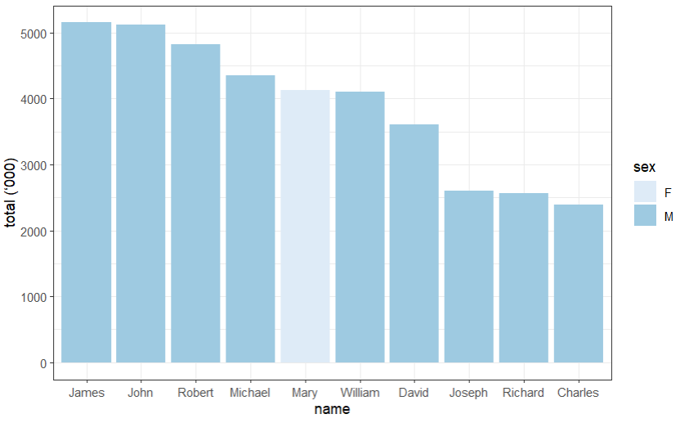

Slide 110
babynames %>%
group_by(name, sex) %>%
summarise(total = sum(n)) %>%
arrange(desc(total)) %>%
ungroup() %>%
slice_head(10) %>%
ggplot(aes(x = fct_reorder(name, desc(total)), y = total/1000, fill = sex)) +
geom_col() +
theme_bw() +
scale_fill_brewer() +
labs(x = "name", y = "total (‘000)")

Slide 111
babynames %>%
filter(name == "Khaleesi" & sex == "F") %>%
summarise(total = sum(n))
## total
## 1 1964
Can we do this for
each name?

Slide 112

babynames %>%
filter(name == "Khaleesi" & sex == "F") %>%
summarise(total = sum(n))
babynames %>%
group_by(name, sex) %>%
summarise(total = sum(n))
Group by the variables you used to get your test case

Slide 113
babynames %>%
filter(name == "Khaleesi" & sex == "F") %>%
summarise(total = sum(n))
babynames %>%
group_by(name, sex) %>%
summarise(total = sum(n)) %>%
arrange(desc(total))

Slide 114
How should we define popularity?
A name is popular if:
Sums - a large number of children have the name when you sum across years
Ranks - it consistently ranks among the top names from year to year.
How could this
be biased?
114

Slide 115
babynames %>%
filter(year == 2017) %>%
summarise(total = sum(n))
## total
## 1 3546301
babynames %>%
filter(year == 1880) %>%
summarise(total = sum(n))
## total
## 1 201484
3,546,301
201,484

Slide 116
Your Turn 10
Use group_by() to calculate the total number of children born for every year.
Plot the results as a line graph: total vs. year.
03:00
116

Slide 117
babynames %>%
group_by(year) %>%
summarise(n_children = sum(n)) %>%
ggplot(aes(x = year, y = n_children)) +
geom_line()
117

Slide 118
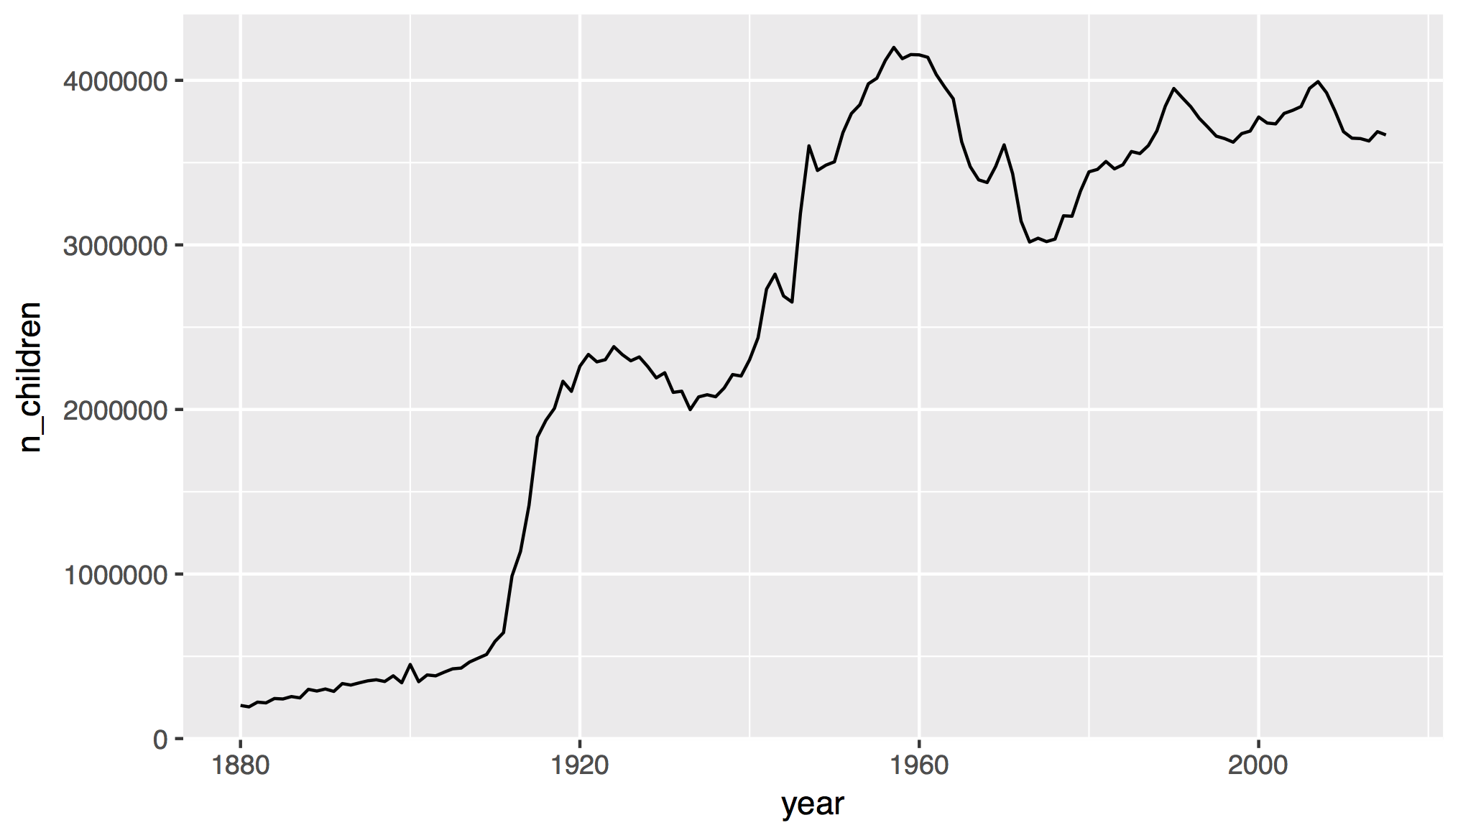
118

Slide 119
How should we define popularity?
A name is popular if:
Sums - a large number of children have the name when you sum across years
Ranks - it consistently ranks among the top names from year to year.
119

Slide 120
Quiz
Do we have enough information to:
Rank names within each year?
120

Slide 121
mutate()

Slide 122
mutate()
Create new columns.
babynames %>%
mutate(percent = round(prop*100, 2))
babynames
year | sex | name | n | prop
1880 | M | John | 9655 | 0.0815
1880 | M | William | 9532 | 0.0805
1880 | M | James | 5927 | 0.0501
1880 | M | Charles | 5348 | 0.0451
1880 | M | Garrett | 13 | 0.0001
1881 | M | John | 8769 | 0.081
1881 | M | William | 8524 | 0.0787
1881 | M | James | 5442 | 0.0503
1881 | M | Charles | 4664 | 0.0431
1881 | M | Garrett | 7 | 0.0001
1881 | M | Gideon | 7 | 0.0001
year | sex | name | n | prop | percent
1880 | M | John | 9655 | 0.0815 | 8.15
1880 | M | William | 9532 | 0.0805 | 8.05
1880 | M | James | 5927 | 0.0501 | 5.01
1880 | M | Charles | 5348 | 0.0451 | 4.51
1880 | M | Garrett | 13 | 0.0001 | 0.01
1881 | M | John | 8769 | 0.081 | 8.1
1881 | M | William | 8524 | 0.0787 | ratio
1881 | M | James | 5442 | 0.0503 | 9.15
1881 | M | Charles | 4664 | 0.0431 | 22.42
1881 | M | Garrett | 7 | 0.0001 | 15.46
1881 | M | Gideon | 7 | 0.0001 | 25.32

Slide 123
mutate()
Create new columns.
babynames %>%
mutate(percent = round(prop*100, 2), nper = round(percent))
babynames
year | sex | name | n | prop
1880 | M | John | 9655 | 0.0815
1880 | M | William | 9532 | 0.0805
1880 | M | James | 5927 | 0.0501
1880 | M | Charles | 5348 | 0.0451
1880 | M | Garrett | 13 | 0.0001
1881 | M | John | 8769 | 0.081
1881 | M | William | 8524 | 0.0787
1881 | M | James | 5442 | 0.0503
1881 | M | Charles | 4664 | 0.0431
1881 | M | Garrett | 7 | 0.0001
1881 | M | Gideon | 7 | 0.0001
year | sex | name | n | prop | percent | nper
1880 | M | John | 9655 | 0.0815 | 8.15 | 8
1880 | M | William | 9532 | 0.0805 | 8.05 | 8
1880 | M | James | 5927 | 0.0501 | 5.01 | 5
1880 | M | Charles | 5348 | 0.0451 | 4.51 | 5
1880 | M | Garrett | 13 | 0.0001 | 0.01 | 0
1881 | M | John | 8769 | 0.081 | 8.1 | 8
1881 | M | William | 8524 | 0.0787 | ratio
1881 | M | James | 5442 | 0.0503 | 9.15
1881 | M | Charles | 4664 | 0.0431 | 22.42
1881 | M | Garrett | 7 | 0.0001 | 15.46
1881 | M | Gideon | 7 | 0.0001 | 25.32

Slide 124
babynames %>%
mutate(rank = min_rank(desc(prop)))
?

Slide 125
Vectorized functions
Take a vector as input.
Return a vector of the same length as output.
on back
125

Slide 126
min_rank()
A go-to ranking function (ties share the lowest rank)
min_rank(c(50, 100, 100, 1000))
# [1] 1 2 2 4
min_rank(desc(c(50, 100, 100, 1000)))
# [1] 4 2 2 1
126

Slide 127
Your Turn 11
Rank the names
Fill in the blanks to rank each name within its year and sex.
02:00
127

Slide 128
babynames %>%
group_by(year, sex) %>%
mutate(rank = min_rank(desc(n)))
## Groups: year, sex [276]
# year sex name n prop rank
# 1 1880 F Mary 7065 0.0724 1
# 2 1880 F Anna 2604 0.0267 2
# 3 1880 F Emma 2003 0.0205 3
# 4 1880 F Elizabeth 1939 0.0199 4
# 5 1880 F Minnie 1746 0.0179 5
# 6 1880 F Margaret 1578 0.0162 6
# 7 1880 F Ida 1472 0.0151 7
## … with 1,924,655 more rows

Slide 129
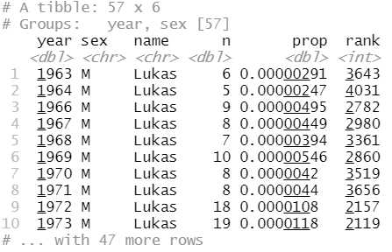
babynames %>%
group_by(year, sex) %>%
mutate(rank = min_rank(desc(n))) %>%
filter(name == "Lukas")

Slide 130
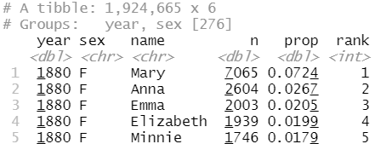
Step 1
Rank the names for each year and sex
130

Slide 131
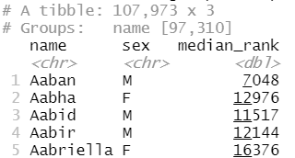
Step 2
Rank the names for each year and sex
Compute the median rank for each name
131

Slide 132
Your Turn 12
Calculate the median ranks
Fill in the blanks to compute the median of the ranks for each name (i.e., for each combination of name and sex). Arrange the results from highest median rank to lowest.
03:00
132

Slide 133
babynames %>%
group_by(year, sex) %>%
mutate(rank = min_rank(desc(prop))) %>%
group_by(name, sex) %>%
summarise(median_rank = median(rank)) %>%
arrange(median_rank)
# name sex score
# 1 Mary F 1
# 2 James M 3
# 3 John M 3
# 4 William M 4
# 5 Robert M 6
# … with 107,963 more rows
133

Slide 134
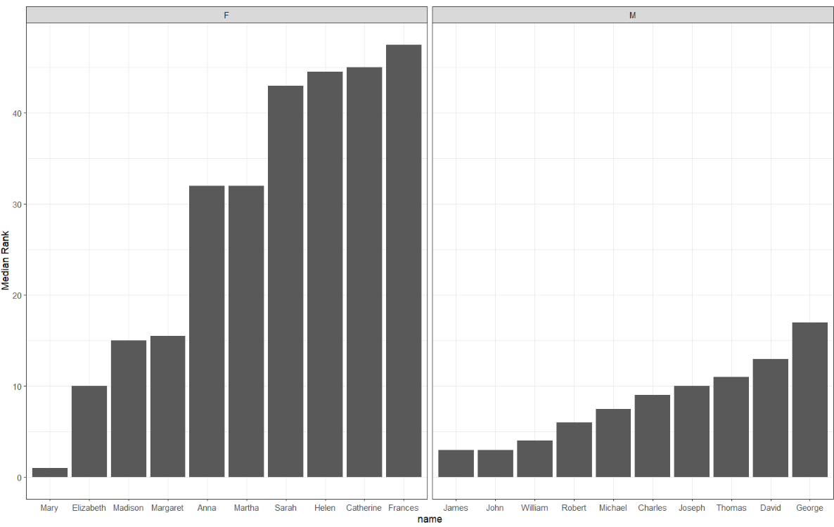

Slide 135
babynames %>%
group_by(year, sex) %>%
mutate(rank = min_rank(desc(prop))) %>%
group_by(name, sex) %>%
summarise(median_rank = median(rank)) %>%
group_by(sex) %>%
arrange(median_rank) %>%
slice(1:10) %>%
ggplot() +
geom_col(mapping = aes(x = fct_reorder(name, median_rank), y = median_rank)) +
facet_wrap(vars(sex), scales = "free_x") +
theme_bw() +
labs(x = "name", y = "Median Rank")

Slide 136
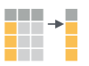
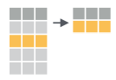
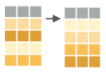
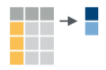
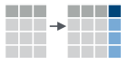
Recap: Single table verbs
Extract variables with select()
Extract cases with filter()
Arrange cases, with arrange() + desc().
Make tables of summaries with summarise().
Make new variables, with mutate().
136

Slide 137
$

Slide 138

select()
Extract columns by name.
select(babynames, n)
babynames
year | sex | name | n | prop
1880 | M | John | 9655 | 0.0815
1880 | M | William | 9532 | 0.0805
1880 | M | James | 5927 | 0.0501
1880 | M | Charles | 5348 | 0.0451
1880 | M | Garrett | 13 | 0.0001
1881 | M | John | 8769 | 0.081
1881 | M | William | 8524 | 0.0787
1881 | M | James | 5442 | 0.0503
1881 | M | Charles | 4664 | 0.0431
1881 | M | Garrett | 7 | 0.0001
1881 | M | Gideon | 7 | 0.0001
n
9655
9532
5927
5348
13
8769
8524
5442
4664
7
7
Still a dataframe

Slide 139
$
Extract column contents as a vector.
babynames$n
babynames
year | sex | name | n | prop
1880 | M | John | 9655 | 0.0815
1880 | M | William | 9532 | 0.0805
1880 | M | James | 5927 | 0.0501
1880 | M | Charles | 5348 | 0.0451
1880 | M | Garrett | 13 | 0.0001
1881 | M | John | 8769 | 0.081
1881 | M | William | 8524 | 0.0787
1881 | M | James | 5442 | 0.0503
1881 | M | Charles | 4664 | 0.0431
1881 | M | Garrett | 7 | 0.0001
1881 | M | Gideon | 7 | 0.0001
9655 9532 5927 5348 …

Slide 140
$
Extract column contents as a vector.
babynames$n
data frame
$
column name (no quotes)
140

Slide 141
pull()
Pipe friendly version of $
babynames %>% pull(n)
babynames
year | sex | name | n | prop
1880 | M | John | 9655 | 0.0815
1880 | M | William | 9532 | 0.0805
1880 | M | James | 5927 | 0.0501
1880 | M | Charles | 5348 | 0.0451
1880 | M | Garrett | 13 | 0.0001
1881 | M | John | 8769 | 0.081
1881 | M | William | 8524 | 0.0787
1881 | M | James | 5442 | 0.0503
1881 | M | Charles | 4664 | 0.0431
1881 | M | Garrett | 7 | 0.0001
1881 | M | Gideon | 7 | 0.0001
9655 9532 5927 5348 …

Slide 142
Transform Data with

